Slide 1
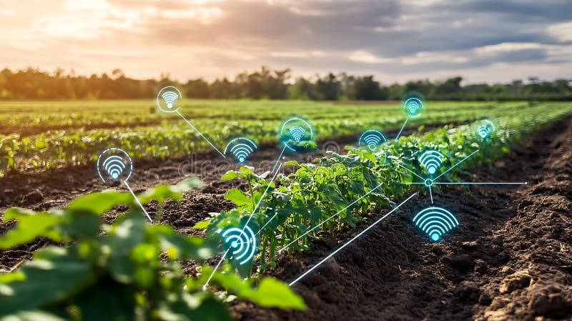
M.SC. MAJOR PROJECT REPORT
A Mist-Fog-Assisted Real-Time Pest Detection and Classification Framework Using Deep Transfer Learning for Smart Agriculture
Sujeet Kumar
M.Sc. Computer Science | University of Delhi
Roll No: 24234747005
Supervisor: Dr. Dilip Senapati
Academic Year 2025-2026
DUCS | DELHI

Slide 2
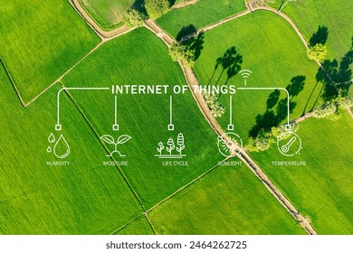
PRESENTATION OVERVIEW
01
Introduction & Motivation
Contents
Smart Agriculture 4.0, pest threats, edge intelligence, and project objectives
02
Related Work & Research Gap
A comprehensive overview of the Mist-Fog-Assisted pest detection framework covering architecture, methodology, and experimental validation.
IoT architectures, lightweight deep learning models, and identified gaps
03
Proposed System Architecture
Three-tier Mist-Fog-Cloud topology and optimization framework
04
Methodology & Implementation
Dataset preparation, augmentation, model architecture, and training setup
05
Experimental Results
Training convergence, classification metrics, hardware profiling, and benchmarks
06
Conclusion & Future Scope
Summary of contributions, environmental impact, and future research directions

Slide 3
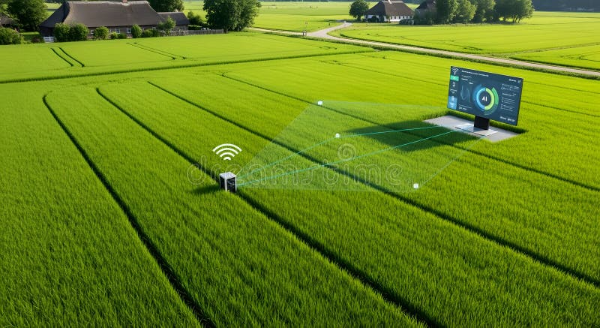
01
INTRODUCTION & MOTIVATION
Smart Agriculture 4.0, pest threats, edge intelligence challenges, and project objectives

Slide 4
Introduction
Related Work
Architecture
Methodology
Results
Conclusion
Smart Agriculture 4.0 and Precision Farming
The Global Agricultural Challenge
Global population projected to reach 10 billion by 2050, demanding dramatic yield increases under severe ecological constraints: land depletion, water scarcity, and climate volatility.
Agriculture 4.0 Paradigm
A radical transformation from experience-based farming to data-driven, precise intervention models. Relies on IoT sensors, UAVs, automated telemetry, and localized analytics.
Precision Farming Principle
Spatial and temporal variation management — applying water, fertilizers, and pest treatments precisely where and when needed through a continuous loop of data collection, processing, and actuation.
Core Requirement
Robust, autonomous computation pipelines operating within extreme physical and electrical constraints of remote field environments.
POPULATION BY 2050
CROP YIELD LOSS
10B
20-40%
IoT-enabled precision farming with multi-modal sensors
Smart Agriculture 4.0 integrates embedded sensors for soil moisture, humidity, temperature, and high-resolution visual feeds to generate actionable diagnostic models.
04

Slide 5
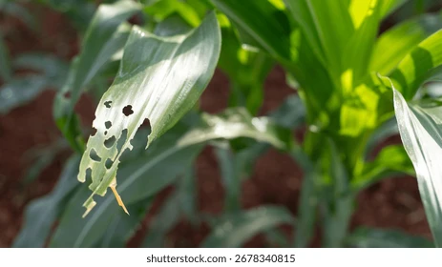
Introduction
Related Work
Architecture
Methodology
Results
Conclusion
Pest Threats and Limitations of Traditional Methods
Traditional Manual Inspection
For centuries, pest management relied on manual field inspection — farmers walking fields, visually scanning for damage. This approach is:
Labor-intensive, slow, and subjective
Comprehensive monitoring of large farmlands is physically impossible
Minor infestations overlooked in early stages
By the time damage is visible, localized control is no longer feasible
Ecological Consequences of Late Detection
Late detection forces uniform pesticide spraying across entire farmlands, causing:
Accelerated chemical toxicity in soils
Pollution of adjacent water tables through runoff
Destruction of beneficial insects (predators, pollinators)
Rapid pest resistance to chemical treatments
Severe health risks from pesticide residues on food
The Solution: Automated, continuous visual monitoring for early, localized pest detection and ecological intervention.
Crop damage caused by insect pest infestation
ANNUAL CROP LOSS (FAO)
20-40%
of global crop yields destroyed by plant pests and diseases annually, resulting in hundreds of billions of dollars in direct financial losses
05

Slide 6
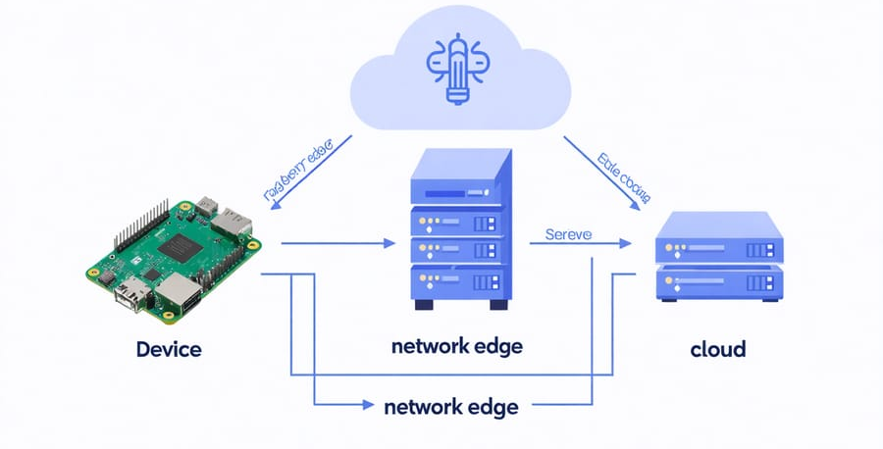
Introduction
Related Work
Architecture
Methodology
Results
Conclusion
Edge Intelligence and Hierarchical Computing
The Cloud-Centric Bottleneck
Standard CNNs (VGG, ResNet, DenseNet) contain tens of millions of parameters requiring cloud data centers. Agricultural farmlands have weak or no connectivity, making centralized approaches impractical.
Edge Intelligence Solution
Run deep learning models on local hardware at the farm boundary — eliminating external network dependency, slashing communication delays to milliseconds, and ensuring data privacy.
Mist Layer
Fog Layer
Cloud Layer
Ultra-low-power nodes (ESP32-CAM, MCUs) in pheromone traps. Responsible for data ingestion, ROI cropping, and short-range wireless transmission via LoRaWAN or Zigbee.
Single-board computers (Raspberry Pi, NVIDIA Jetson) running the core MobileNetV3-Large model. Delivers real-time classification within milliseconds, operates without internet.
Receives compressed metadata logs for regional pest migration tracking and heavy model retraining cycles. Eliminates raw image transmission upstream.
06

Slide 7
Introduction
Related Work
Architecture
Methodology
Results
Conclusion
Project Objectives and Key Contributions
Primary Objective: Design, implement, and validate a fully functional, decentralized Mist-Fog-Cloud computing framework enabling real-time, autonomous pest detection and classification directly at the agricultural field boundary.
KEY CONTRIBUTIONS
01
02
03
Scalable Three-Tier Topology
Edge-Tailored Transfer Learning
Adaptive Data Balancing
A Mist-Fog-Cloud layout optimized for isolated field environments, demonstrating localized processing eliminates external delays and maintains diagnostic autonomy during network blackouts.
An optimized MobileNetV3-Large core that runs efficiently within strict thermal, memory, and processing boundaries of low-power single-board computers at the farm edge.
A dynamic weighted random sampler within the training loop to eliminate majority class bias and ensure high generalization accuracy across deeply skewed agricultural datasets.
04
05
Automated Mixed Precision & Early Stopping
Comprehensive Edge Benchmarking
AMP configurations and early stopping mechanisms to accelerate optimization convergence, reduce training memory footprints, and prevent overfitting during edge model training.
Empirical profiling of the finalized edge core against EfficientNet-B0, ResNet18, and EfficientNetV2-S on physical Raspberry Pi hardware, establishing a generalizable smart farming strategy.
07

Slide 8
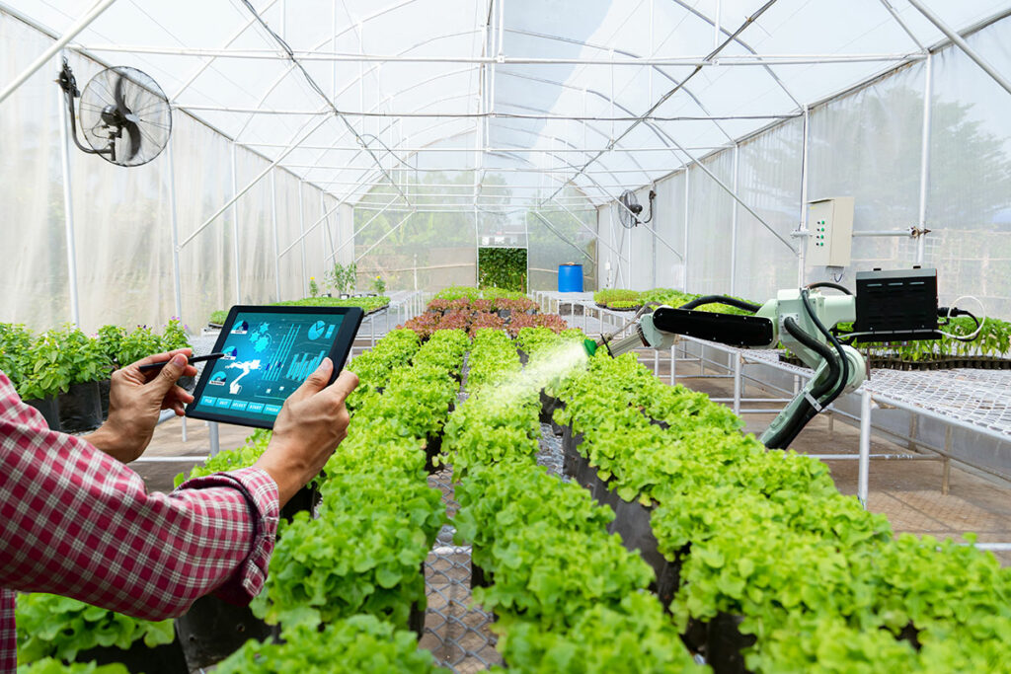
02
RELATED WORK & RESEARCH GAP
Review of IoT architectures, lightweight deep learning models, and the identified research gap

Slide 9
Introduction
Related Work
Architecture
Methodology
Results
Conclusion
Literature Review: Architectures and Models
IOT ARCHITECTURES & DATA MANAGEMENT
LIGHTWEIGHT DEEP LEARNING MODELS
Kalyani & Collier [1] — Systematic survey on Cloud-Fog-Edge computing for smart agriculture. Offloading time-sensitive tasks to edge layers drastically reduces latency and energy consumption.
Li et al. [5] — Lightweight locality-aware model using MobileNetV3 integrated with YOLO detector for real-time pest detection. Proved that compact architectures drastically reduce parameters and GFLOPs while maintaining or improving mean Average Precision for small pest targets.
Gomez et al. [2] — FARMIT multi-tier platform for continuous crop quality assessment. Edge plane manages localized monitoring and aggregates heterogeneous sensor data.
Key Synthesis from Literature
The literature establishes a clear consensus:
The future of sustainable precision agriculture relies on decentralized Cloud-Fog-Edge architectures with localized data filtering and secure edge operations.
These must be powered by highly compressed, lightweight deep learning models like MobileNetV3 for continuous crop and pest assessment.
However, existing works address either architecture or models — rarely both together.
Javeed et al. [3] — Intrusion detection system for edge-envisioned smart agriculture. Edge nodes are highly susceptible to tampering and cyber attacks, requiring autonomous security.
Abdalzaher et al. [4] — Quality-Focused IoT data management. Edge nodes must act as intelligent filters, dropping redundant data to avoid network saturation.
09

Slide 10
Introduction
Related Work
Architecture
Methodology
Results
Conclusion
Identified Research Gap and Our Approach
Research Gap 1: Hardware Neglect
Our Holistic Approach
Lightweight pest detection studies frequently treat deployment hardware as an afterthought, ignoring the dynamic queuing delays, packet loss, and network transmission overheads that occur when multiple mist node cameras flood a shared fog workstation simultaneously.
We bridge this divide by proposing a holistic framework that tightly couples:
Three-tier Mist-Fog-Cloud architectural hierarchy with a meticulously optimized, class-balanced MobileNetV3-Large core.
Key integrated features:
Robust data augmentation pipeline
Automated mixed precision training
Early stopping mechanisms
Dynamic class balancing via weighted random sampler
This ensures edge intelligence can be reliably deployed to protect crop yields without relying on external cloud connectivity.
Research Gap 2: Missing Model Details
Architectural IoT studies outline robust data pathways but rarely detail the internal transfer learning strategies, class-balancing techniques, or hyperparameter optimizations required to make complex multi-class visual models function accurately within network constraints.
10

Slide 11
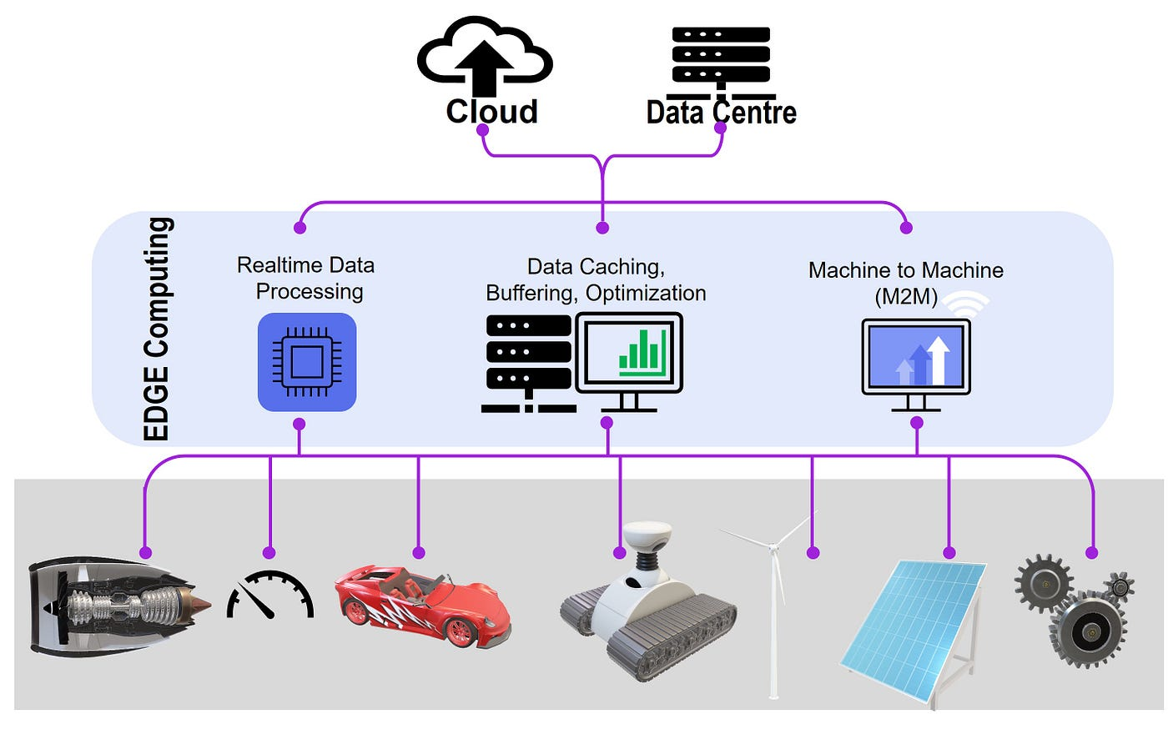
03
PROPOSED SYSTEM ARCHITECTURE
Three-tier topology, network modeling, and class-balanced optimization framework

Slide 12
Introduction
Related Work
Architecture
Methodology
Results
Conclusion
Three-Tier Mist-Fog-Cloud Topology
Mist Layer
Fog Layer
Cloud Layer
DATA INGESTION BOUNDARY
LOCALIZED COMPUTATION
GLOBAL ANALYTICS
Devices: ESP32-CAM, MCUs, camera modules
Location: Pheromone traps, mobile robots
Functions:
Visual feed capture
ROI cropping
Image compression
LoRaWAN/Zigbee transmission
Devices: Raspberry Pi, NVIDIA Jetson
Location: On-site farm workstation
Functions:
Aggregates mist trap feeds
Manages execution queues
Runs MobileNetV3-Large
Diagnostics in milliseconds
No internet required
Role: Global analytical engine
Input: Compressed metadata logs
Functions:
Pest migration tracking
Model retraining cycles
Trend analysis
Closed-loop management
Key Design Principles
Autonomy: Complete operational independence during total external network failures
Low Latency: Visual data packages processed within 23.5 milliseconds at the fog layer
Bandwidth Efficiency: Only compressed metadata transmitted to cloud — raw images stay local
12

Slide 13
Introduction
Related Work
Architecture
Methodology
Results
Conclusion
Class-Balanced Optimization and Edge Efficiency
COMPUTATIONAL EFFICIENCY
CLASS IMBALANCE SOLUTION
Depthwise Separable Convolutions
Replaces standard convolutions by decoupling spatial filtering and channel combination into two separate steps:
Step 1: Depthwise convolution applies a single spatial filter to each input channel
Step 2: Pointwise convolution (1x1 kernel) combines channel dimensions
This achieves computational reduction by an order of magnitude without compromising feature resolution.
The Challenge
Real-world datasets have severely skewed distributions — common pests heavily outnumber rare, highly destructive species.
The Problem
Standard training with uniform cross-entropy loss introduces majority class bias — the network overfits to dominant classes while failing to classify rare targets.
Our Solution
A dynamic weighted random sampler computing inverse-probability sampling weights for each class, ensuring balanced batch distributions.
KEY ARCHITECTURAL FEATURES
Inverted Residuals
Coord. Attention
Hard-Swish Activation
Weighted Sampler
Projects low-dimensional tensors into expanded space for feature tracking, then compresses back with linear bottlenecks preserving structural data.
Localized coordinate attention and squeeze-and-excitation modules amplify diagnostic landmarks while suppressing ambient trap noise.
Replaces expensive sigmoid with piece-wise linear approximation, enabling non-linear activations via basic bitwise operations on edge CPUs.
Dynamic class-balanced sampling ensures every training batch presents uniform distribution, eliminating majority-class overfitting.
13

Slide 14
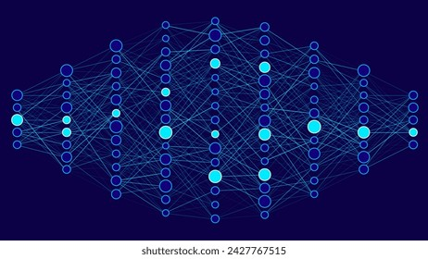
04
METHODOLOGY & IMPLEMENTATION
Dataset preparation, augmentation pipeline, model architecture, and training configurations

Slide 15
Introduction
Related Work
Architecture
Methodology
Results
Conclusion
Dataset Description and Augmentation Pipeline
DATASET OVERVIEW
AUGMENTATION PIPELINE
9 distinct insect categories reflecting real-world smart farming scenarios:
Aphids, Armyworm, Beetle, Bollworm, Grasshopper, Mites, Mosquito, Sawfly, and Stem Borer
Challenges:
Aphids and mites are extremely small — require high-resolution detail
Beetle and sawfly share visual overlaps (torso, coloration, wings)
Severe class imbalance in raw sample distribution
All images standardized to 224x224 pixels with ImageNet normalization (mean=[0.485, 0.456, 0.406], std=[0.229, 0.224, 0.225]).
Dynamic augmentations applied during each epoch to prevent overfitting and improve out-of-domain generalization:
Random Flips
Affine Rotations
Horizontal and vertical reflections with probability p = 0.5
Rotations within [-30, +30] degrees for camera angle variations
DATA SPLIT
Color Jittering
Perspective Transform
80:20 training-validation split ensures robust evaluation bounds while maintaining sufficient data for deep transfer learning fine-tuning.
Brightness, contrast, saturation, hue variation (max factor 0.2)
Scale 0.2 to handle distorted or partially occluded insects
Class Imbalance Justification: Common pests (aphids, beetle) are majority classes; rare species (sawfly, stem borer) are significantly underrepresented. This justifies the weighted random sampler integration.
15

Slide 16
Introduction
Related Work
Architecture
Methodology
Results
Conclusion
MobileNetV3-Large Architecture and Training Setup
MODEL ARCHITECTURE
Core Backbone: MobileNetV3-Large pre-trained on ImageNet
Key Architectural Components:
Depthwise separable convolutions — reduce parameters and FLOPs by an order of magnitude
Inverted residual blocks with linear bottlenecks — preserve information through deep layers
Squeeze-and-excitation modules — dynamic per-channel excitation weights
Coordinate attention — enhance fine-grained pest tracking
Hard-swish activation — efficient edge CPU execution
MODEL SPECIFICATIONS
DISK SIZE
GFLOPs
CLASSES
16.4
0.62
9
MEGABYTES
PER INFERENCE
PEST CATEGORIES
Data Balancing Strategy
WeightedRandomSampler computes inverse-probability sampling weights for each class. Every training batch presents a uniform, balanced distribution — forcing the optimizer to distribute gradient updates evenly across common and minority categories.
Training Optimizations
AdamW optimizer with decoupled weight decay prevents parameter expansion
Cosine annealing LR scheduler smoothly scales step size for stable convergence
AMP (16-bit forward/backward) halves memory footprint and doubles processing speed
Early stopping monitors validation loss, exports optimal parameters, prevents overfitting
TRAINING CONFIGURATIONS
Parameter | Value
Optimizer | AdamW (decoupled weight decay)
Initial Learning Rate | 0.001
LR Scheduler | Cosine Annealing
Precision | Automated Mixed Precision (AMP)
Early Stopping | Patience=5, Min Delta=1e-4
16

Slide 17
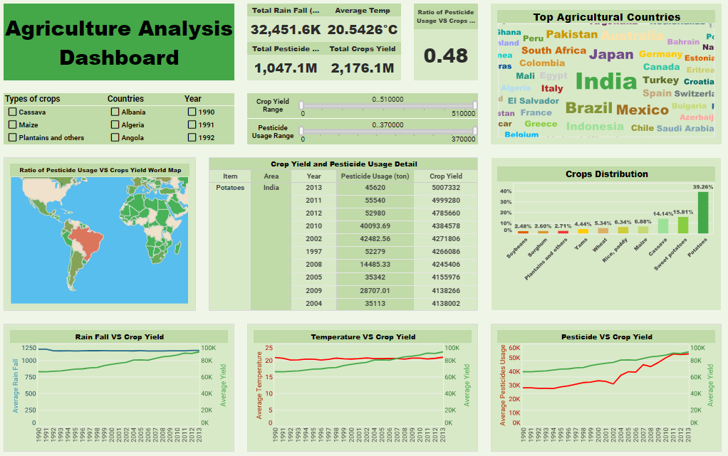
05
EXPERIMENTAL RESULTS
Training convergence, classification performance, hardware profiling, and model comparison

Slide 18
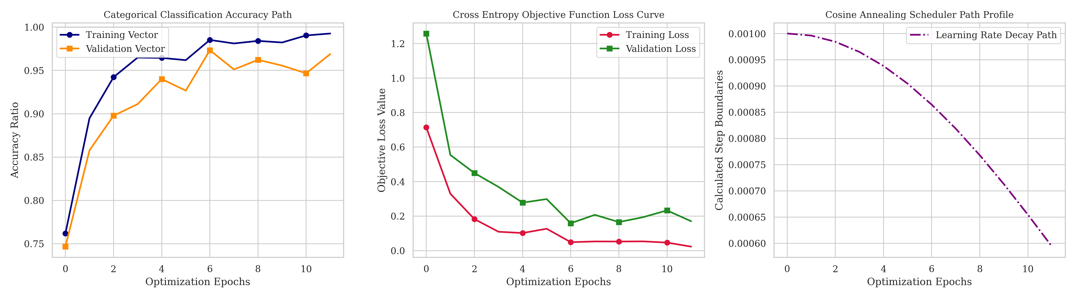
Introduction
Related Work
Architecture
Methodology
Results
Conclusion
Training Convergence and Classification Performance
EXPERIMENTAL SETUP
Training on GPU workstation (16GB VRAM) | Deployment on Raspberry Pi 4 Model B (4GB RAM) | Raspberry Pi OS
VAL. ACCURACY
MACRO PRECISION
MACRO RECALL
MACRO F1-SCORE
97.33%
98.00%
98.00%
98.00%
TRAINING CONVERGENCE ANALYSIS
CONFUSION MATRIX INSIGHTS
Loss Trajectory
Cross-entropy loss initiates near 1.4 and drops sharply during the first 6 epochs, stabilizing below 0.17 at convergence. Validation loss remains tightly coupled with training curve throughout.
Accuracy Trajectory
Top-1 validation accuracy rises smoothly from below 75% to a high-performance plateau at 97.33%. Minimal gap between training and validation accuracy proves effective regularization.
Early Stopping
Training successfully terminated after epoch 12, preventing overfitting and exporting optimal parameter weights.
Diagonal Dominance
Highly defined diagonal configuration indicating a high rate of true positive classifications across all 9 pest categories. Directly attributed to the weighted random sampler integration.
Minor Off-Diagonal Scattering
Restricted to isolated local blocks where species share extreme anatomical overlaps — subtle variations in wing venation or identical segmented torso layouts (minor overlaps between bollworm, mites, and sawfly).
All per-class F1-scores exceed 0.93, with most achieving 0.98 or 1.00, demonstrating the class-balanced objective function effectively guarded minority class representations.
18

Slide 19
Introduction
Related Work
Architecture
Methodology
Results
Conclusion
Edge Hardware Profiling and Model Comparison
HARDWARE PROFILING (RASPBERRY PI 4)
MODEL SIZE
COMPLEXITY
MEMORY DRAW
INFERENCE
FRAME RATE
CPU USAGE
16.4 MB
0.62 GFLOPs
44.2 MB
23.5 ms
42.5 FPS
38.4%
MODEL COMPARISON BENCHMARK
Model | Best Val Acc (%) | Inference (ms) | Disk Size (MB) | Peak Memory (MB)
MobileNetV3-L | 95.78% | 5.73 | 16.07 | 1,249.68
EfficientNet-B0 | 97.11% | 7.42 | 15.33 | 2,358.05
ResNet18 | 95.56% | 2.06 | 42.65 | 2,358.05
EfficientNetV2-S | 97.33% | 16.40 | 77.01 | 3,593.29
Best Balance | MobileNetV3-L
Key Insight: MobileNetV3-Large achieves the best operational balance — its peak memory is approximately half of EfficientNet-B0/ResNet18 and one-third of EfficientNetV2-S, preventing thermal throttling and enabling parallel communication tasks on 4GB RAM edge nodes.
19

Slide 20
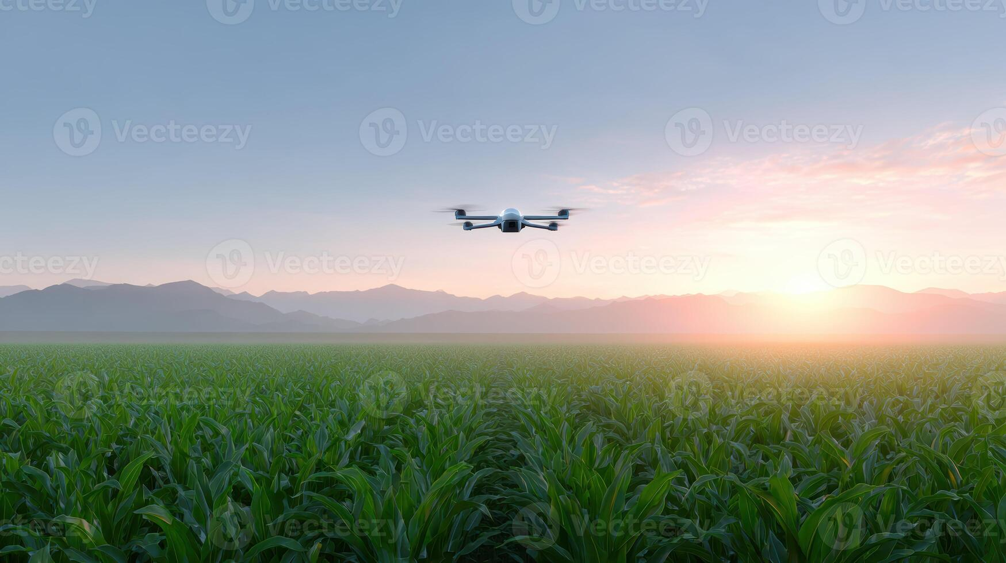
06
CONCLUSION & FUTURE SCOPE
Summary of contributions, environmental and economic impacts, and future research directions

Slide 21
Introduction
Related Work
Architecture
Methodology
Results
Conclusion
Summary, Impact, and Future Directions
SUMMARY OF CONTRIBUTIONS
ENVIRONMENTAL & ECONOMIC IMPACT
Environmental Benefits
Enables targeted pesticide application instead of blanket spraying
Minimizes chemical production costs
Slows pesticide resistance mutations in target species
Protects local ecosystems and water tables from toxic runoff
Economic Benefits
Early detection prevents minor infestations from becoming regional crises
Preserves agricultural yields and secures food supply chains
The framework successfully bridges the gap between resource-constrained edge hardware and complex computer vision tasks:
97.33% validation accuracy
0.62 GFLOPs computational complexity
16.4 MB model footprint
23.5 ms inference latency
All achieved without internet connectivity.
FUTURE RESEARCH DIRECTIONS
Federated Learning
Multi-Modal Sensor Fusion
Autonomous Field Robotics
Enable multiple agricultural sites to optimize convolutional layers cooperatively, updating master model weights without exposing private raw field images to external servers.
Combine visual RGB arrays with real-time environmental telemetry (micro-climate, humidity, soil chemistry) to construct predictive, proactive risk maps for pest outbreaks.
Port the edge inference core onto autonomous mobile field robots and automated trap actuators to realize a fully self-correcting agricultural protection system.
21

Slide 22
THANK YOU
Questions & Discussion Welcome
Sujeet Kumar
M.Sc. Computer Science | University of Delhi
Roll No: 24234747005
Supervisor: Dr. Dilip Senapati
ACADEMIC YEAR 2025-2026

